Slide 1
LMC
April 2021

Slide 2
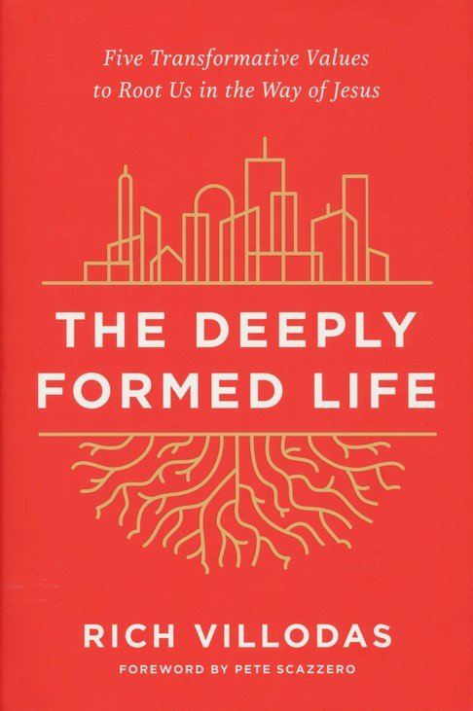
Rich Villodas The Deeply Formed Life
“What is bothering me incessantly is the question what
Christianity really is, or indeed who Christ really is, for us today.” p 215
Dietrich Bonhoeffer, 1944
“In the beginning the church was a fellowship of men and women centered on the living Christ. Then the church moved to Greece, where it became a philosophy. Then it moved to Rome, where it became an institution. Next, it moved to Europe, where it became a culture. And, finally, it moved to America, where it became an enterprise.”
Richard Halvorsen, former chaplain to U.S. Senate

Slide 3
Questions for reflection
“Has the contemporary church been so captivated by the images and methods of consumer culture that it has forfeited its sacred vocation to be a countercultural agent of God’s kingdom in the world?”
Examples?
Q. What are we to do about it?

Slide 4
Five important questions
How can Christians continue to live lives at a destructive pace that eliminates any semblance of abiding with Jesus in prayer?
How can we still hold deeply racist beliefs?
How can we remain emotionally dysfunctional?
How can we separate physical and spiritual life?
How can we live lives indistinguishably from the world?

Slide 5
MINISTRY PRACTICES
SILENT PRAYER IS ONE OF THE GREATEST GIFTS WE HAVE TO EXPERIENCE THE DEEPLLY FORMED LIFE IN CHRIST.
(ILLUS)
2. SABBATH IS AN INVITATION TO A LIFE THAT ISN’T DOMINATED AND DISTORTED BY OVERWORK. (Moves from production to presence)
3. SOAKING IN SCRIPTURE (lectio, meditation, oratio, contemplatio)
4. HAVING DONE ALL TO STAND – STAND!

Slide 6
Neurotheology
***The best witness we have is our transformed lives.***
“Having the right answers to the questions of faith is helpful but will not do much to form people in the way of Jesus.”
Keys to formational change:
R – remain relational
A – Act like yourself (authentic)
R – Return to joy (Psalm 16:11 KJV)
E – Endure hardship well (Joy set before you)

Slide 7
The practice of JOY!
Striving vs. Practices
“Our brains draw life from our strongest relational attachments to grow our character and develop our identity. Who we love shapes who we are.”
Terry Wardle Identity Matters

Slide 8
Transmitting Joy
Fruit of the Spirit (Galatians 5:22,23) “Love, joy, peace, patience, kindness, goodness, faithfulness, gentleness and self control.”
Jesus (John 15:11-13) connects love of God with joy.
“I have told you this so that my joy may be in you and that your joy may be complete.” :13 “mature” The Message
“My Father’s face lights up when He sees Me because I’m so special to him.” Wilder p57 Renovated

Slide 9
Importance of Joy
Joy is transmitted person to person (eyes)
Joy is relational (attachment)
Joy is important to God therefore to me
HESED (Hebrew love has direct connect to attachment and joy)

Slide 10
The Divine Commodity Skye Jethani
“Consumer Christianity, while promising to strengthen our souls with an entertaining faith, has left us malnourished with an anemic view of God, faith, church and mission.”
We kill the church when we make Christianity about fulfilling a vision” p 171
Because the impetus to fulfil a vision attachment love gives way to burnout.
P 172 “Striving is what we do when a good idea is not working well enough.”

Slide 11
PRACTICES THAT MAY BE HELPFUL
WHERE DO I SENSE MOST STRESS IN MY LIFE?
WHAT PRACTICES EQUIP ME FOR THIS SEASON OF LIFE?
ARE THERE GAPS IN MY MINISTRY?
WHERE AM I CALLED TO LEAD OTHERS?
WHAT PRACTICES MIGHT HELP ME TO HELP OTHERS?

Slide 12
HESED (chesed) Attachment Love.
God gives us life, allows no one in His place, sees us as special grace, builds our joy, lets us rest, thinks with us, draws close and moves away, shares good and bad times with us, helps us discover our true selves, gives us freedom but stays hesed, stretches us to grow, and makes us part of God’s people.
“It is not information we lack for discipleship, rather it is joy in our relational soil. A lack of hesed leaves us with a great omission. “ Dallas Willard
Hesed (chesed)= people who value relationships above performance or productivity. A committed love! Isaiah 54:10

Slide 13
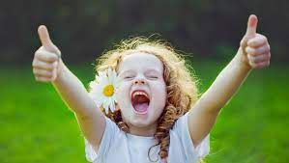
JOYFULNESS!

